Slide 1
Information Processing Techniques
Week 15
Abeeha Sattar

Slide 2
Threading using C# and .NET

Slide 3
Threads
Thread is the fundamental unit of execution.
More than one thread can be executing code inside the same process (application).
On a single-processor machine, the operating system is switching rapidly between the threads, giving the appearance of simultaneous execution.

Slide 4
Why do we use threads?
Maintain a responsive user interface while background tasks are executing
Distinguish tasks of varying priority
Perform operations that consume a large amount of time without stopping the rest of the application

Slide 5
Threading: Advantages and Dangers
Main
Thread
Reasons to use Threading
Timers
UI Responsiveness
Multiple processors
Dangers
Race Conditions
Deadlock
Child
Thread

Slide 6
Race Condition
if (x == 5) // t0 and t1 {
y = x * 2; // The "Act"
// If another thread changed x in between "if (x == 5)" and "y = x * 2" above,
// y will not be equal to 10. }

Slide 7
Spawning a new Thread
IO
Delegates
System.Thread

Slide 8
System. Threading Namespace
Provides classes and interfaces that enable multithreaded programming.
Consists of classes for synchronizing thread activities .
Chief among the namespace members is Thread class

Slide 9
Thread Class
Implements various methods & properties that allows to manipulate concurrently running threads.
Some of them are :
- CurrentThread
- IsAlive
- IsBackground
- Name
- Priority
- ThreadState

Slide 10
Thread Constructor
Takes a ThreadStart delegate
ThreadStart(void () target)
Takes a method which returns void and has no params:
void MyMethod()
Thread begins execution when Start() is called
Thread executes method passed to ThreadStart

Slide 11
Thread Properties
IsBackground
get or set
Once all foreground threads are finished, the runtime calls Abort on all background threads
Default is false (or foreground)
Priority
ThreadPriority Enum
Lowest, BelowNormal, Normal, AboveNormal, Highest
ThreadState
New Thread: ThreadState.Unstarted
Started Thread: ThreadState.Running
Sleep called: ThreadState.WaitSleepJoin
Suspend called: ThreadState.Suspended
See ThreadState Enumeration

Slide 12
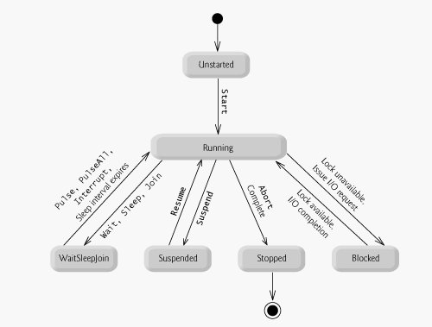
Thread States / Lifecycle

Slide 13
Thread Methods
Start()
Begins execution of the thread
Once a thread is finished, it cannot be restarted
Suspend()
Suspends the thread
If the thread is already suspended, there is no effect
Resume()
Resumes a suspended thread
Interrupt()
Resumes a thread that is in a WaitSleepJoin state
If the thread is not in WaitSleepJoin state it will be interrupted next time it is blocked

Slide 14
Thread Methods
Abort()
Attempts to abort the thread
Throws a ThreadAbortException
Join()
Blocks the calling thread until the owning thread terminates
Sleep()
Suspends the current thread for the specified amount of time

Slide 15
Exceptions Between threads
Must be handled in the thread it was thrown in
Exceptions not handled in the thread are considered unhandled and will terminate that thread

Slide 16
Starting a Thread
Thread thread = new Thread(new ThreadStart (ThreadFunc));
//Creates a thread object
// ThreadStart identifies the method that the thread executes when it
//starts
thread.Start();
//starts the thread running

Slide 17
Suspending and Resuming Threads
Thread.Suspend temporarily suspends a running thread.
Thread.Resume will get it running again
Sleep : A thread can suspend itself by calling Sleep.
Difference between Sleep and Suspend
A thread can call sleep only on itself.
Any thread can call Suspend on another thread.

Slide 18
Terminating a thread
Thread.Abort() terminates a running thread.
In order to end the thread , Abort() throws a ThreadAbortException.
Suppose a thread using SQL Connection ends prematurely , we can close the the SQL connection by placing it in the finally block.
- SqlConnection conn ………
try{
conn.open();
….
.....
}
finally{
conn.close();//this gets executed first before the thread ends.
}

Slide 19
A thread can prevent itself from being terminated with Thread.ResetAbort.
- try{
…
}
catch(ThreadAbortException){
Thread.ResetAbort();
}
Thread.Join()
When one thread terminates another, wait for the other thread to end.

Slide 20
Synchronization Classes and Constructs
lock keyword
Mutex class
Monitor class
Interlocked class

Slide 21
The lock Keyword
Marks a statement as a critical section
Is a Monitor underneath
Example:
lockObject must be a reference-type instance
Typically you will lock on:
‘this’
locks the current instance
typeof(MyClass)
global lock for the given type
A collection instance
locks access to a specific collection
lock(lockObject) {
// critical section }

Slide 22
The lock Mutex
lock defines one Mutex for each object locked on
Blocks until the current thread is finished

Slide 23
Mutex Class
Stands for Mutual-Exclusion
Blocking synchronization object
WaitOne()
Begins the critical section
ReleaseMutex()
Ends critical section
Call ReleaseMutex() in a finally block

Slide 24
Monitor Class (static)
Enter(object obj)
Begins a critical section
Blocks if another thread has the same lock
Exit(object obj)
Ends a critical section
Releases the lock
TryEnter(object obj)
Returns true if it obtains the lock
Returns false if it can’t obtain the lock
Avoids blocking if you can’t obtain the lock
Wait(object obj)
Releases the lock on an object and blocks until it reaquires the lock
Pulse(object obj)
Signals the next waiting thread that the lock may be free
PulseAll(object obj)
Signals all waiting threads that the lock may be free

Slide 25
Thread Synchronization / Monitors
Thread Synchronization
Threads must be coordinated to prevent data corruption.
Monitors
Monitors allow us to obtain a lock on a particular object and use that lock to restrict access to critical section of code.
While a thread owns a lock for an object, no other thread can acquire that lock.
Monitor.Enter(object) claims the lock but blocks if another thread already owns it.
Monitor.Exit(object) releases the lock.

Slide 26
The C # Lock Keyword :
lock(buffer){ ……. }
is equivalent to
Monitor.Enter(buffer); try { critical section; } finally { Monitor.Exit(buffer); }
Makes the code concise.
Also ensures the presence of a finally block to make sure the lock is released.

Slide 27
Interlocked Class (static)
Provides atomic operations for variables
CompareExchange(ref int dest, int source, int compare)
Replaces dest with source if dest == compare
Overloaded
Exchange(ref int dest, int source)
places source into dest
returns the original value of dest
Increment(ref int value)
increments value
Decrement(ref int value)
decrements value

Slide 28
MethodImpl Attribute
For synchronizing access to entire methods.
To prevent a method from be executed by more than one thread at a time ,
[MethodImpl (MethodImplOptions.Synchronized)]
Byte[] TransformData(byte[] buffer)
{
……
}
Only one thread at a time can enter the method.

Slide 29
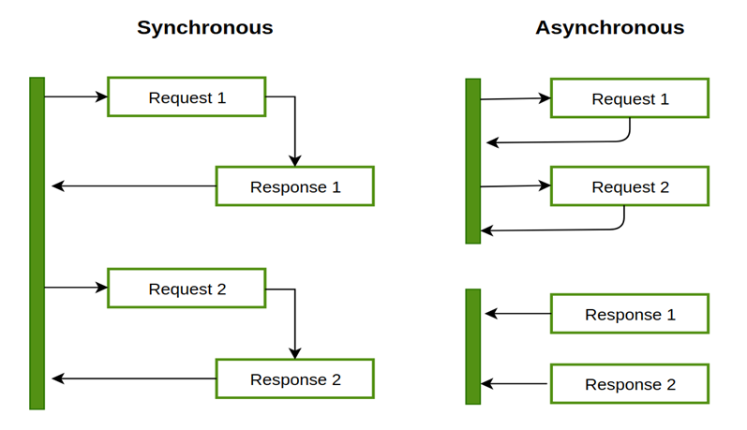
Sync v/s ASync

Slide 30
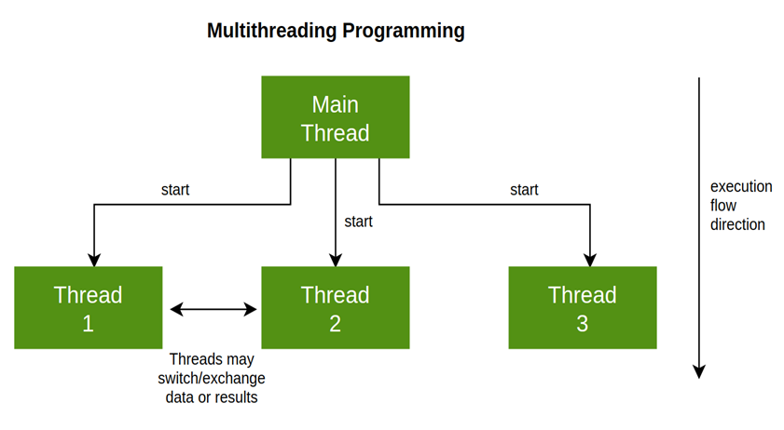
Multithreading

Slide 31
Reading on ASync
Asynchronous programming in C# | Microsoft Docs (https://docs.microsoft.com/en-us/dotnet/csharp/programming-guide/concepts/async/)

Slide 32
Fin.

